Slide 1
Process Management
Presentation by :
Balaji Gudala

Slide 2
contents
Introduction to process
Major functionalities of Operating System
what are the process states
Different types of Terminations on a process
Creating a process
Difference between fork and vfork system calls
Blocking calls used in process
Sending signals to the process
Exec family of calls

Slide 3
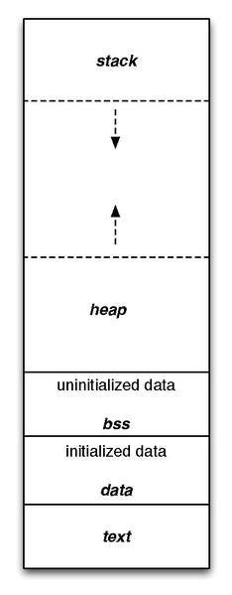
What is a process ?
Program which is under execution is called process
A process is an instance of a computer program being executed using code and instructions
Each process uses system resources like CPU or RAM to complete the specific tasks
Each process creates its own Process Control Block (PCB) in kernel space of RAM.
Context Switching :
context switching involves storing the content of general purpose CPU registers of a process in the context area of the PCB . So that it can be resumed from the same point as earlier
Pre-emption :
Its is the act of temporarily interrupting a task and switching to the next process . Before pre-emption the context switching .

Slide 4
.
What is an Operating System ( OS )
An operating system is a executable binary file that control the execution of application programs and act as an interface between the user of a computer and the computer hardware .
What is kernel ?
The kernel is a executable binary file , which is a main core component in Operating System (OS) . The kernel has the complete control over everything in system .
What is Process Management ?
The process is a program in execution. The process is created when a command is to be executed so, it can be called a running instance of a program in execution. Tuning or controlling a process is called Process Management .

Slide 5
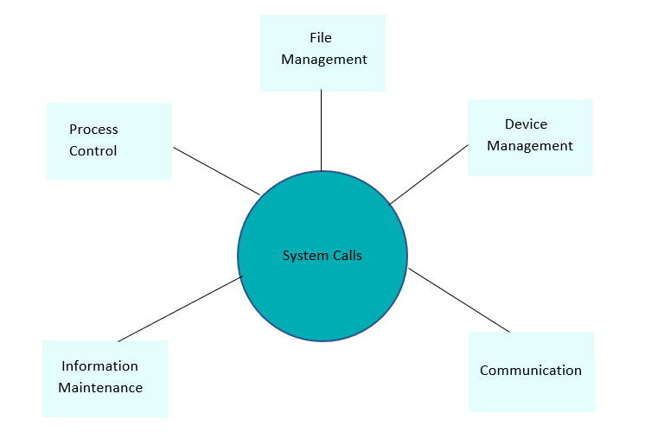
.
The major functionalities of operating system :
The main sub components of kernel are :
Process Management
Memory Management
File Management
Network Management
Hardware device drivers ( Input / Output )
Every process is created from another process
The init process ,which is created with the PID of one (1) , this init process is loaded by scheduler (swapper) , These process are loaded at system booting time .
Every process has an PCB in the kernel space of RAM .
When the process is created . The information of the process is stored in structure . This is known as Process Control Block (PCB).

Slide 6
The structure for PCB is task_struct (longest structure in Kernel) which is in #include<sched.h>
PCB is unique for every process which consists of various attributes such as PID , PPID , Owner ID , Group ID , Process status , Context area , Signal Disposition (SD) table , Signals information , Signal mask , Time stamps , File Descriptive (FD) table and so on .
All these PCB are maintained as nodes in circular double linked list as the running queue and waiting queue .
What is system call ?
A system call is a function that a user program uses to ask the operating system for a particular service . This may include hardware-related services ,creation and execution of new processes and communication with integral kernel service such as a process scheduling.
Each system calls has a unique positive numbers , Approximately in linux we have 300 + system calls .

Slide 7
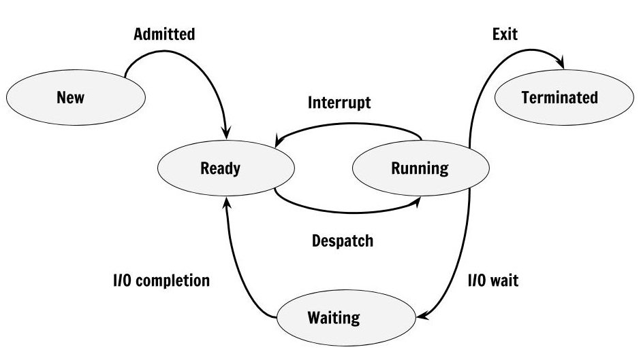
What are the Process states ?
Process goes through different states throughout the life cycle which are called process states.
New, Ready, Running, Waiting or Block, Terminated or Completed are different states which process might go during the life cycle.
The state of the process is stored as member in Process Control Block(PCB). PCB is a special data structure that stores information about the process.
New State :
This is the first state of the process life cycle. When process creation is taking place, the process is in a new state .
Ready State :
The process is loaded into the main memory and will be placed in the queue of processes which are waiting for the CPU allocation .

Slide 8
Running State : ( R )
Whenever the CPU is allocated to the process from the ready queue, the process state changes to Running .
Block or Wait State : ( S & D )
When we use the blocking calls like scanf( ) and wait( ) system calls .The PCB is moved from running queue to waiting queue until the process receives the any one of the signal .
S ➔ Interruptible sleep state .
D ➔ Uninterruptable sleep state .
Terminated or Completed state :
When the entire set of instructions is executed and the process is completed. The process state is changed to terminated or completed state . During this state the PCB of that process is also deallocated .
Zombie state : (Z)
when the process is terminated its sends the signal to its parent process , but the parent process is unable to receives the signal from the terminated child process , this state of terminated (child) process is called zombie state .

Slide 9
How to observe the processes information ?
Sr.No. | Column & Description
1 | UID User ID that this process belongs to (the person running it)
2 | PID Process ID
3 | PPID Parent process ID (the ID of the process that started it)
4 | C CPU utilization of process
5 | STIME Process start time
6 | TTY Terminal type associated with the process
7 | TIME CPU time taken by the process
8 | CMD The command that started this process
There are two ways to watch the processes information.
They are :
1) By using the Graphical User Interface (GUI) .
2) By using Command Line Interface(CLI) .
We can observe the entries of that processes in the proc virtual file system under root directory through GUI .
By using the commands like
ps –ef -> we can see the processes running in your system and some of its process members information like pid , ppid , stime and so on .
ps ax ->we can see the all processes running in your system and state of the process along with the pid , stime (start time) .

Slide 10
Difference types terminations on a process
The kernel notifies the termination of process to its parent process in the form of signal . We can see normal termination or abnormal termination (wait( ) and waitpid( )) , when the process terminates .
Normal termination
Return from the function ( return( ) )
Calling exit function ( exit( ) )
Calling _exit( ) system call
Return of its last thread from its start routine
Calling pthread_exit( ) from the last thread
Abnormal termination
Calling abort( ) function from a process , which will generate core dump file .
After receiving the signal (or) After caught the signal
Response of the last thread to a cancellation request (pthread_cancel( ))

Slide 11
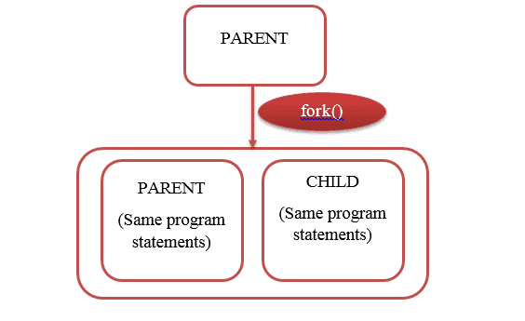
How to create a new process
The system calls below are used for creating process
Fork( );
Vfork( );
Clone( );
The above calls internally invoke the do_fork( ) system call .
Fork( ) - system call
We have to #include<unistd.h> header file .
typedef int pid_t ;
Syntax : pid_t fork( void ) ;
This fork system call return minus one ( -1) on failure
On success this call return twice , child pid and zero respectively .

Slide 12
Program to understand the fork( ) system call
#include<stdio.h>
#include<unistd.h>
void main( )
{
pid_t pid ;
pid = fork( );
if(pid < 0 ) {
printf(“ The call is failed to create the process \n ”);
exit( 1);
}
if(pid>0)
{
printf(“Parent : PID : %d \n “ , getpid( ) );
printf(“Parent : child PID : %d \n “ , pid );
printf(“Parent : PPID : %d \n “ ,getppid( ) );
}
else
{
printf(“child : PID : %d \n “ , getpid( ) );
printf(“child : parent PID : %d \n “ ,getppid( ) );
}
}
Output :
// assume
Parent : PID : 1054
Parent : child PID : 1055
Parent : PPID : 1051
Child : PID : 1055
Child : parent PID : 1054

Slide 13
Difference between fork( ) and vfork( ) system calls
Vfork( )
Fork( )
In fork( ) system call , parent and child have separate memory space .
The parent and child process get executed simultaneously .
The fork( ) system call uses copy-on-write (COW) technique as an alternative.
Child process doesn’t suspend the parent process execution in fork( ) system call .
There is wastage of address space .
Page of one process is not affected by page of another process .
fork( ) system call is more used .
While in vfork( ) system call , child and parent share same address space .
After the termination of child only , the parent process starts its execution .
While vfork( ) system call doesn’t use any copy-on-write .
Child process suspends the parent process in vfork( ) system call .
There is no wastage of address space .
Page of one process is affected by page of another process .
vfork( ) system call is less used .

Slide 14
Blocking calls used in processes
Some of the Blocking calls are
Wait( ) system call :
This call is used in process to block or suspend the current process . The wait( ) system call wait for the terminating signal from any one of the child process to continue the current process.
The header file we have to include #include<unistd.h>
Syntax: pid_t wait(int *statloc) ;
In the statloc variable the kernel will update the terminated child process exit status .
Waitpid( ) system call :
This call is also like as the wait( ) system call but the waitpid( ) system call wait for the terminated signal from the particular child processes only , To continue the current process .
Syntax : pid_t waitpid(pid_t pid , int *statloc , int options ) ;

Slide 15
Program to understand wait ( ) system call .
#include<unistd.h> #include<stdio.h>
int main( )
{
pid_t pid , cpid ; int stat = 0 , i = 0 ;
pid = fork( ) ;
if( pid < 0 )
{
printf(“failed to create the process \n “) ;
exit(1);
}
else if( pid > 0)
{
// sleep(20) ;
printf(“In parent : \n parent pid : %d \n child pid : %d \n”, getpid( ),pid) ;
cpid = wait(&stat) ;
}
else
{
printf(“In child :\n parent pid : %d\n child pid : %d \n” , getppid( ),getpid( ));
while(1)
printf(“%d “, i++);
}
}
Output :
//Assume
In parent :
parent pid : 19371
child pid : 19372
In child :
parent pid : 19371
child pid : 19372
0 1 2 3 4 5 6 7 8 9

Slide 16
sending the signals to process
Some of the system calls to send the signals to process .
Raise( ) system call :
This call is used to pass the signal to current running process from the same process.
We have to #include<singal.h> header file
Syntax : int raise( int signo) ;
Kill( ) system call :
This call is used to send the signal to the processes created by user , By giving the PID number and signal number or signal name as input to the kill( ) system call .
Syntax : int kill(pid_t pid , int signo ) ;
Equivalent kill( ) system call to raise( ) system call is
kill(getpid( ),signo) ⬅➔ raise(signo)

Slide 17
Replacing the current process image with new process image
The exec family of system calls are used to replaces the program executed by a process . When a process calls exec( ) system call , all code (text) and data in the process is lost and replaced with the executable of the new program .
We have to include<unistd.h> header file .
Syntax : int excel(const char* path/file name , const char * argo , . . . (char *)o ) ;
int execlp(const char* file name , char * const char * argo, … (char*)o ) ;
int execv(const char* path/filename , char * const argv[ ] ) ;
int execp(const char * file name , char* const argv[ ] ) ;
int execle(const char* path , const char* argo ,…(char*)o , char* const envp[ ]) ;
int execel(const char* path , const char* argv[ ] , char* const envp[ ]) ;

Slide 18
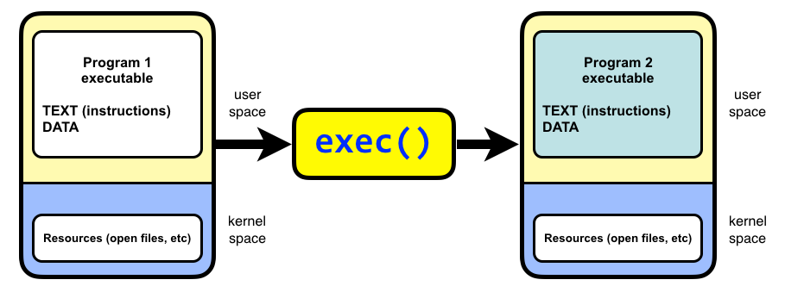
Program to understand the exec family of call
#include<stdio.h>
#include<unistd.h>
int main( )
{
pid_t var1 , var2 ;
char * str[ ] = { “ ps ” , “ -ef “ , NULL ) ;
var1 = fork( ) ;
if( var1 < 0 )
{ printf(“ failed to create the new process \n “);
exit(1);
}
else if(var1 > 0 )
{
sleep(1) ;
execvp( str[0] , str ) ;
}
else
{
printf( “ entered int o child process “ ) ;
}
}

Slide 19
references
Book References :
The linux programming by Michael kerisk
Website Reference :
JavaTpoint.com
Scalar .com
Tutorial point.com

Slide 20
.
Thank you !

Slide 21
.
Any Queries ?

